Slide 1

HARI PRAKASH.K.K
Final Project

Slide 2
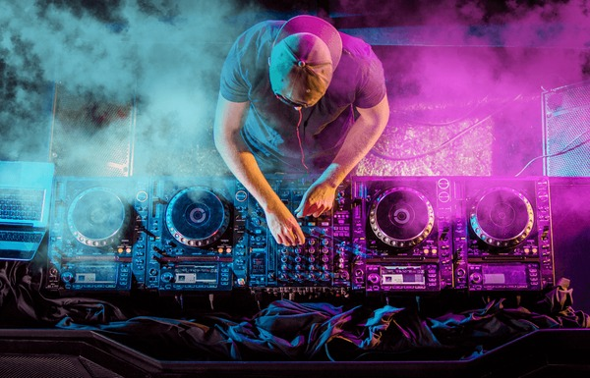
PROJECT TITLE
AI DJ: Creating Dynamic Music Mixes with Generative Models

Slide 3


AGENDA
Introduction
Problem Statement
Project Overview
End Users
Solution and Value Proposition
Key Features
Modeling Approach
Results
Conclusion
3/21/2024 Annual Review

Slide 4
INTRODUCTION
The "AI DJ" project aims to transform the music mixing landscape by leveraging generative AI models. DJs face challenges in creating dynamic mixes that cater to varied audience preferences. Our solution employs AI to dynamically mix tracks in real-time, enhancing performances and delighting audiences. Join us on this journey to revolutionize live music experiences with AI DJ.

Slide 5

PROBLEM STATEMENT
DJs often face challenges in creating seamless and engaging music mixes, especially in live settings where audience preferences vary. There is a need for an intelligent system that can dynamically generate music mixes tailored to the audience's preferences.

Slide 6

PROJECT OVERVIEW
Our project aims to develop an AI-powered DJ system that uses generative models to dynamically mix music tracks in real-time, creating seamless transitions and adjusting the mix based on the audience's feedback.

Slide 7

WHO ARE THE END USERS?
DJs and music producers
Event organizers and clubs
Music enthusiasts and listeners

Slide 8

YOUR SOLUTION AND ITS VALUE PROPOSITION
Our solution is an AI DJ system that leverages generative models to:
Dynamically mix music tracks in real-time
Adapt to audience preferences and mood
Create seamless transitions and engaging music experiences

Slide 9
YOUR SOLUTION AND ITS VALUE PROPOSITION
Value Proposition:
Enhance DJ performances with AI assistance
Delight audiences with personalized music experiences
Increase engagement and satisfaction at events and parties

Slide 10

THE WOW IN YOUR SOLUTION
The wow factor in our solution lies in its ability to:
Analyze crowd feedback and preferences in real-time
Seamlessly blend music tracks across different genres and tempos
Continuously learn and improve its mixing capabilities through AI algorithms
3/21/2024 Annual Review
10

Slide 11
MODELLING
Data collection: Gather a diverse dataset of music tracks spanning various genres and styles.
Preprocessing: Extract features such as tempo, key, and mood from the music tracks.
Model selection: Explore and implement generative models like LSTM or GANs for music generation.
Training: Train the model on the dataset to learn the patterns and transitions between music tracks.
Real-time adaptation: Develop algorithms to adjust the mix based on real-time feedback and audience preferences.
11

Slide 12
RESULTS
Evaluation metrics: Accuracy, coherence, and user satisfaction ratings.
Performance benchmarks: Comparison with traditional DJ methods and existing AI DJ systems.
User feedback: Testimonials and reviews from DJs, event organizers, and audience members.
12

